Slide 1
UNIT- II
PROCESS MANAGEMENT AND PROCESS SYNCHRONIZATION

Slide 2
UNIT II PROCESS MANAGEMENT AND PROCESS SYNCHRONIZATION
Processes - Process Concept - Process Scheduling - Operations on Processes - Inter-process
Communication - CPU Scheduling - Scheduling criteria - Scheduling algorithms. Threads - Multithread
Models – Threading issues. Process Synchronization - The Critical-Section problem - Synchronization
hardware – Semaphores – Mutex - Classical problems of synchronization – Monitors.

Slide 3
Processes

Slide 4
Processes
Process Concept
Process Scheduling
Operations on Processes
Inter-process Communication

Slide 5
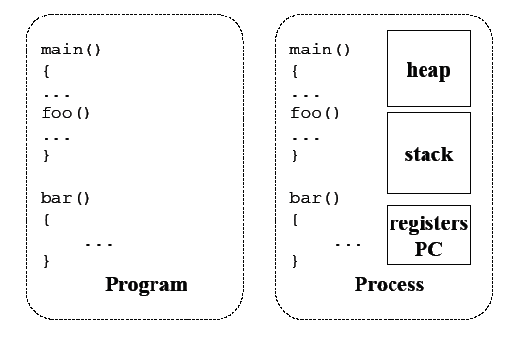
Process Concept
An operating system executes a variety of programs:
  Batch system – jobs
  Time-shared systems – user programs or tasks
Process – a program in execution; process execution must progress in sequential fashion

Slide 6
Process Concept
Process contain multiple parts
  The program code, also called text section
  Current activity including program counter, processor registers
  Stack containing temporary data
    Function parameters, return addresses, local variables
  Data section containing global variables
  Heap containing memory dynamically allocated during run time

Slide 7

Process in Memory

Slide 8
Process Concept
Program is passive entity stored on disk (executable file), process is active
  Program becomes process when executable file loaded into memory
Execution of program started via GUI mouse clicks, command line entry of its name, etc
One program can be several processes
  Consider multiple users executing the same program

Slide 9
Process State
As a process executes, it changes state
The state of a process is defined in part by the current activity of that process.
A Process may be in one of the following states
  new: The process is being created
  running: Instructions are being executed
  waiting: The process is waiting for some event to occur
  ready: The process is waiting to be assigned to a processor
  terminated: The process has finished execution

Slide 10

Process State

Slide 11

Process Control Block (PCB)
Each process is represented in the operating system by a process control block (PCB)—also called a task control block.

Slide 12
Information associated with each process
Process state – The state may be new, ready, running, waiting, halted, and so on.
Program counter – The counter indicates the address of the next instruction to be executed for this process.
CPU registers – The registers vary in number and type, depending on the computer architecture. They include accumulators, index registers, stack pointers, and general- purpose registers, plus any condition-code information.
CPU scheduling information - priorities, scheduling queue pointers

Slide 13
Memory management information –This information may include such items as the value of the base and limit registers and the page tables, or the segment tables, depending on the memory system used by the operating system memory allocated to the process
Accounting information – includes the amount of CPU and real time used, time limits, account numbers, job or process numbers, and so on.
I/O status information – I/O devices allocated to process, list of open files

Slide 14

CPU Switch From Process to Process

Slide 15
Process Scheduling
Maximize CPU use, quickly switch processes onto CPU for time sharing
Process scheduler selects among available processes for next execution on CPU
Maintains scheduling queues of processes
  Job queue – set of all processes in the system
  Ready queue – set of all processes residing in main memory, ready and waiting to execute
  Device queues – set of processes waiting for an I/O device
  Processes migrate among the various queues

Slide 16

Representation of Process Scheduling
Queueing diagram represents queues, resources, flows

Slide 17
Queueing Diagram
Each rectangular box represents a queue.
Two types of queues are present:
  The ready queue and a set of device queues.
  The circles represent the resources that serve the queues,
  The arrows indicate the flow of processes in the system.

Slide 18
Queueing diagram
A new process is initially put in the ready queue. It waits there until it is selected for execution, or dispatched.
Once the process is allocated the CPU and is executing, one of several events could occur:
  The process could issue an I/O request and then be placed in an I/O queue.
  The process could create a new child process and wait for the child’s termination.
  The process could be removed forcibly from the CPU, as a result of an interrupt, and be put back in the ready queue.

Slide 19
Schedulers
Short-term scheduler (or CPU scheduler) – selects which process should be executed next and allocates CPU
  Sometimes the only scheduler in a system
  Short-term scheduler is invoked frequently (milliseconds) - (must be fast)
Long-term scheduler (or job scheduler) – selects which processes should be brought into the ready queue
  Long-term scheduler is invoked infrequently (seconds, minutes) - (may be slow)
  The long-term scheduler controls the degree of multiprogramming

Slide 20
Schedulers
Processes can be described as either:
  I/O-bound process – spends more time doing I/O than computations, many short CPU bursts
  CPU-bound process – spends more time doing computations; few very long CPU bursts
Long-term scheduler strives for good process mix

Slide 21

Addition of Medium Term Scheduling
Medium-term scheduler can be added if degree of multiple programming needs to decrease
  Remove process from memory, store on disk, bring back in from disk to continue execution: swapping

Slide 22
Context Switch
When CPU switches to another process, the system must save the state of the old process and load the saved state for the new process via a context switch
Context of a process represented in the PCB
Context-switch time is overhead; the system does no useful work while switching
  The more complex the OS and the PCB the longer the context switch
Time dependent on hardware support
  Some hardware provides multiple sets of registers per CPU multiple contexts loaded at once

Slide 23
Operations on Processes
System must provide mechanisms for:
  process creation
  process termination

Slide 24
Process Creation
Parent process create children processes, which, in turn create other processes, forming a tree of processes
Generally, process identified and managed via a process identifier (pid)
Resource sharing options
  Parent and children share all resources
  Children share subset of parent’s resources
  Parent and child share no resources
Execution options
  Parent and children execute concurrently
  Parent waits until children terminate

Slide 25

Process Creation
Address space
  Child duplicate of parent
  Child has a program loaded into it
UNIX examples
  fork() system call creates new process
  exec() system call used after a fork() to replace the process’ memory space with a new program

Slide 26
Process Termination
Process executes last statement and then asks the operating system to delete it using the exit() system call.
  Returns status data from child to parent (via wait())
  Process’ resources are deallocated by operating system
Parent may terminate the execution of children processes using the abort() system call. Some reasons for doing so:
  Child has exceeded allocated resources
  Task assigned to child is no longer required
  The parent is exiting and the operating systems does not allow a child to continue if its parent terminates

Slide 27
Process Termination
Some operating systems do not allow child to exists if its parent has terminated. If a process terminates, then all its children must also be terminated.
  cascading termination. All children, grand children, etc. are terminated.
  The termination is initiated by the operating system.
The parent process may wait for termination of a child process by using the wait() system call. The call returns status information and the pid of the terminated process
pid = wait(&status);
If no parent waiting (did not invoke wait()) process is a zombie
If parent terminated without invoking wait , process is an orphan

Slide 28
CPU Scheduling

Slide 29
CPU Scheduling
Basic Concepts
Scheduling Criteria
Scheduling Algorithms
Thread Scheduling
Multiple-Processor Scheduling
Real-Time CPU Scheduling
Operating Systems Examples
Algorithm Evaluation

Slide 30
Basic Concepts
Maximum CPU utilization obtained with multiprogramming
CPU–I/O Burst Cycle – Process execution consists of a cycle of CPU execution and I/O wait
CPU burst followed by I/O burst
CPU burst distribution is of main concern

Slide 31
CPU Scheduler
Short-term scheduler selects from among the processes in ready queue, and allocates the CPU to one of them
  Queue may be ordered in various ways
CPU scheduling decisions may take place when a process:
  1. Switches from running to waiting state
  2. Switches from running to ready state
  3. Switches from waiting to ready
  Terminates
Scheduling under 1 and 4 is nonpreemptive
All other scheduling is preemptive
  Consider access to shared data
  Consider preemption while in kernel mode
  Consider interrupts occurring during crucial OS activities

Slide 32
Dispatcher
Dispatcher module gives control of the CPU to the process selected by the short-term scheduler; this involves:
  switching context
  switching to user mode
  jumping to the proper location in the user program to restart that program
Dispatch latency – time it takes for the dispatcher to stop one process and start another running

Slide 33
Scheduling Criteria
CPU utilization – keep the CPU as busy as possible
Throughput – No of processes that complete their execution per time unit
Turnaround time – amount of time to execute a particular process
Waiting time – amount of time a process has been waiting in the ready queue
Response time – amount of time it takes from when a request was submitted until the first response is produced, not output (for time-sharing environment)

Slide 34
Scheduling Algorithm Optimization Criteria
Max CPU utilization
Max throughput
Min turnaround time
Min waiting time
Min response time

Slide 35
CPU SCHEDULING

Slide 36
Types
1. FCFS
2. SJF
3. Priority
4. Round Robin

Slide 37
MODES OF SCHEDULING
Modes
1. With Arrival Time
2. Without Arrival Time
Modes
1. Preemptive
2. Non-Preemptive

Slide 38
Points to Remember
Calculate :
Finishing Time (FT)
Waiting Time (WT)
Turn Around Time (TAT)
Finishing Time is calculated from Gantt Chart
Waiting Time : FT-AT-BT
TAT : FT-AT
Note: If AT is not given then AT = 0

Slide 39
Problem Statement
Process ID | Arrival Time | Burst Time
P₀ | 0 | 10
P₁ | 5 | 1
P₂ | 2 | 3
P₃ | 3 | 4
P₄ | 1 | 5

Slide 40
FCFS – With Arrival Time
225, 224, 226, 233, 211, 219, 194, 190,218
P₀ | P₄ | P₂ | P₃ | P₁
0 | 10 | 15 | 18 | 22 | 23

Slide 41
FCFS – With Arrival Time
Process ID | Arrival Time | Burst Time | Finishing Time | Waiting Time | TAT
P₀ | 0 | 10 | 10 | 0 | 10
P₁ | 5 | 1 | 23 | 17 | 18
P₂ | 2 | 3 | 18 | 13 | 16
P₃ | 3 | 4 | 22 | 15 | 19
P₄ | 1 | 5 | 15 | 9 | 14

Slide 42
Problem Statement - SJF
Process ID | Arrival Time | Burst Time
P₀ | 0 | 10
P₁ | 5 | 1
P₂ | 2 | 3
P₃ | 3 | 4
P₄ | 1 | 5

Slide 43
SJF – With Arrival Time – Without Preemptive
P₀ | P₁ | P₂ | P₃ | P₄
0 | 10 | 11 | 14 | 18 | 23

Slide 44
SJF – With Arrival Time Without Preemptive
Process ID | Arrival Time | Burst Time | Finishing Time | Waiting Time | TAT
P₀ | 0 | 10 | 10 | ? | ?
P₁ | 5 | 1 | 11 | ? | ?
P₂ | 2 | 3 | 14 | ? | ?
P₃ | 3 | 4 | 18 | ? | ?
P₄ | 1 | 5 | 23 | ? | ?

Slide 45
Problem Statement - SJF
Process ID | Arrival Time | Burst Time
P₀ | 0 | 10
P₁ | 5 | 1
P₂ | 2 | 3
P₃ | 3 | 4
P₄ | 1 | 5

Slide 46
SJF – With Arrival Time – With Preemptive
P₀ | P₄ | P₂ | P₁ | P₄ | P₃ | P₀
0 | 1 | 2 | 5 | 6 | 10 |  | 14 | 23

Slide 47
SJF – With Arrival Time-With Preemptive
Process ID | Arrival Time | Burst Time | Finishing Time | Waiting Time | TAT
P₀ | 0 | 10 | 23 | 13 | 23
P₁ | 5 | 1 | 6 | 0 | 1
P₂ | 2 | 3 | 5 | 0 | 3
P₃ | 3 | 4 | 14 | 7 | 11
P₄ | 1 | 5 | 10 | 4 | 9

Slide 48
Problem Statement - Priority
Process ID | Arrival Time | Burst Time | Priority
P₀ | 0 | 10 | 4
P₁ | 5 | 1 | 5
P₂ | 2 | 3 | 2
P₃ | 3 | 4 | 1
P₄ | 1 | 5 | 3
Note :Shortest value has highest Priority

Slide 49
Priority – With Arrival Time – Without Preemptive
P₀ | P₃ | P₂ | P₄ | P₁
0 | 10 | 14 | 17 | 22 | 23

Slide 50
Priority – With Arrival Time – Without Preemptive
Process ID | Arrival Time | Burst Time | Priority | Finishing Time | Waiting Time | TAT
P₀ | 0 | 10 | 4 | 10 | ? | ?
P₁ | 5 | 1 | 5 | 23 | ? | ?
P₂ | 2 | 3 | 2 | 17 | ? | ?
P₃ | 3 | 4 | 1 | 14 | ? | ?
P₄ | 1 | 5 | 3 | 22 | ? | ?

Slide 51
Problem Statement - Priority
Process ID | Arrival Time | Burst Time | Priority
P₀ | 0 | 10 | 4
P₁ | 5 | 1 | 5
P₂ | 2 | 3 | 2
P₃ | 3 | 4 | 1
P₄ | 1 | 5 | 3
Note :Shortest value has highest Priority

Slide 52
Priority – With Arrival Time – With Preemptive
P₀ | P₄ | P₂ | P₃ | P₂ | P₄ | P₀ | P₁
0 | 1 | 2 | 3 | 7 | 9 | 13 | 22 | 23

Slide 53
Priority– With Arrival Time-With Preemptive
Process ID | Arrival Time | Burst Time | Priority | Finishing Time | Waiting Time | TAT
P₀ | 0 | 10 | 4 | 22 | 12 | 22
P₁ | 5 | 1 | 5 | 23 | 17 | 18
P₂ | 2 | 3 | 2 | 9 | 4 | 7
P₃ | 3 | 4 | 1 | 7 | 0 | 4
P₄ | 1 | 5 | 3 | 13 | 7 | 12

Slide 54
Problem Statement – Round Robin
Process ID | Burst Time
P₀ | 10
P₁ | 5
P₂ | 1
P₃ | 20
Note :Time Quantum = 4 units
Create a Ready Queue

Slide 55

Round Robin–Without Arrival Time
P₀ | P₁ | P₂ | P₃ | P₀ | P₁ | P₃ | P₀ | P₃
0 | 4 | 8 | 9 | 13 | 17 | 18 | 22 | 24 36
Ready Queue

Slide 56
Round Robin – Without Arrival Time
Process ID | Burst Time | Finishing Time | Waiting Time | TAT
P₀ | 10 | 24 | ? | ?
P₁ | 5 | 18 | ? | ?
P₂ | 1 | 9 | ? | ?
P₃ | 20 | 38 | ? | ?

Slide 57
Problem Statement – Round Robin
Process ID | Arrival Time | Burst Time
P₀ | 0 | 10
P₁ | 5 | 1
P₂ | 2 | 3
P₃ | 3 | 4
P₄ | 1 | 5
Note :Time Quantum = 4 units

Slide 58

Round Robin–With Arrival Time
P₀ | P₄ | P₃ | P₂ | P₀ | P₁ | P₄ | P₀
0 | 4 | 8 | 12 | 15 | 19 | 20 | 21 | 23
Ready Queue

Slide 59
Round Robin– With Arrival Time
Process ID | Arrival Time | Burst Time | Finishing Time | Waiting Time | TAT
P₀ | 0 | 10 | 23 | ? | ?
P₁ | 5 | 1 | 20 | ? | ?
P₂ | 2 | 3 | 15 | ? | ?
P₃ | 3 | 4 | 12 | ? | ?
P₄ | 1 | 5 | 21 | ? | ?

Slide 60
Problem Statement – CPU Scheduling
Process ID | Arrival Time | Burst Time
P₁ | 0 | 4
P₂ | 2 | 7
P₃ | 3 | 2
P₄ | 3 | 2
Note :Time Quantum = 1 & 2 units

Slide 61
Problem Statement – CPU Scheduling
Process ID | Burst Time | Priority
P₁ | 8 | 3
P₂ | 3 | 1
P₃ | 4 | 4
P₄ | 2 | 2
P₅ | 6 | 5
All Process arrives in order at same time. Note :Time Quantum = 2 units

Slide 62
Problem Statement – CPU Scheduling
Process ID | Burst Time | Priority | Arrival Time
A | 10 | 5 | 0
B | 6 | 2 | 0
C | 7 | 4 | 1
D | 4 | 1 | 1
E | 5 | 3 | 2
All Process arrives in order at same time. Note :Time Quantum = 2 units

Slide 63
Threads

Slide 64
Threads
A thread is a basic unit of CPU utilization.
It comprises a thread ID, a program counter, a register set, and a stack.
It shares with other threads belonging to the same process its code section, data section, and other operating-system resources, such as open files and signals.
A traditional (or heavyweight) process has a single thread of control.
If a process has multiple threads of control, it can perform more than one task at a time.

Slide 65
Threads
Process has a single thread of execution
Consider having multiple program counters per process
  Multiple locations can execute at once
    Multiple threads of control -> threads
Must then have storage for thread details, multiple program counters in PCB

Slide 66
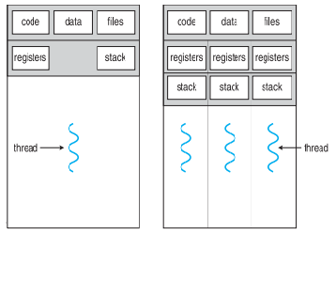
Single and Multithreaded Processes

Slide 67
Motivation
Most modern applications are multithreaded
Threads run within application
Process creation is heavy-weight while thread creation is light-weight
Can simplify code, increase efficiency
Kernels are generally multithreaded

Slide 68
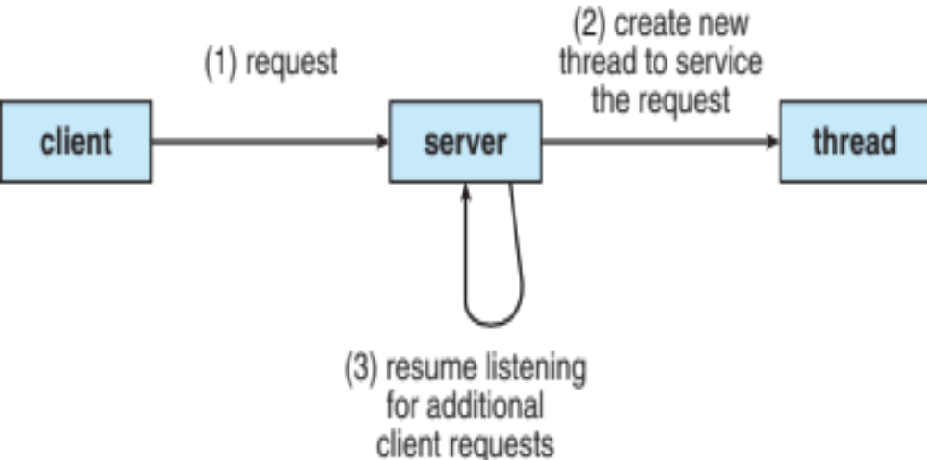
Multithreaded Server Architecture

Slide 69
Benefits
Responsiveness – may allow continued execution if part of process is blocked, especially important for user interfaces
Resource Sharing – threads share resources of process, easier than shared memory or message passing
Economy – cheaper than process creation, thread switching lower overhead than context switching
Scalability – process can take advantage of multiprocessor architectures

Slide 70
Multicore Programming
Multicore or multiprocessor systems putting pressure on programmers, challenges include:
  Dividing activities
  Balance
  Data splitting
  Data dependency
  Testing and debugging
Parallelism implies a system can perform more than one task simultaneously – DATA, TASK Parallelism
Concurrency supports more than one task making progress
  Single processor / core, scheduler providing concurrency

Slide 71


Concurrency vs. Parallelism
Concurrent execution on single-core system:
Parallelism on a multi-core system:

Slide 72
Multithreading Models
User Threads and Kernel Threads
User threads - management done by user-level threads library
Three primary thread libraries:
  POSIX Pthreads
  Windows threads
  Java threads
Kernel threads - Supported by the Kernel
Examples – virtually all general purpose operating systems, including:
  Windows
  Solaris
  Linux
  Tru64 UNIX
  Mac OS X

Slide 73
Multithreading Models
Many-to-One
One-to-One
Many-to-Many

Slide 74
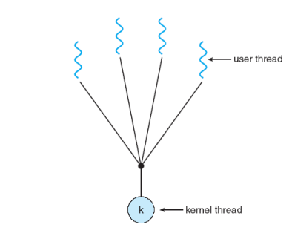
Many-to-One
Many user-level threads mapped to single kernel thread
One thread blocking causes all to block
Multiple threads may not run in parallel on muticore system because only one may be in kernel at a time
Few systems currently use this model
Examples:
  Solaris Green Threads
  GNU Portable Threads

Slide 75

One-to-One
Each user-level thread maps to kernel thread
Creating a user-level thread creates a kernel thread
More concurrency than many-to-one
Number of threads per process sometimes restricted due to overhead
Examples
  Windows
  Linux
  Solaris 9 and later

Slide 76
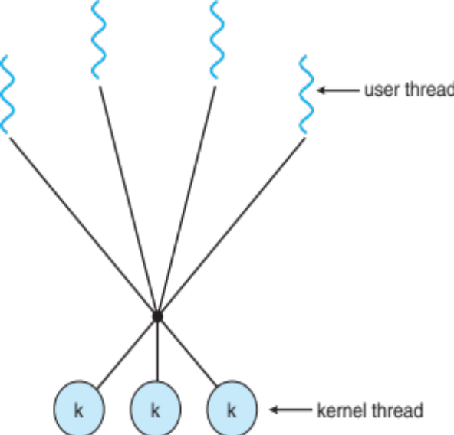
Many-to-Many Model
Allows many user level threads to be mapped to many kernel threads
Allows the operating system to create a sufficient number of kernel threads
Solaris prior to version 9
Windows with the ThreadFiber package

Slide 77

Two-level Model
Similar to M:M, except that it allows a user thread to be bound to kernel thread
Examples
  IRIX
  HP-UX
  Tru64 UNIX
  Solaris 8 and earlier

Slide 78
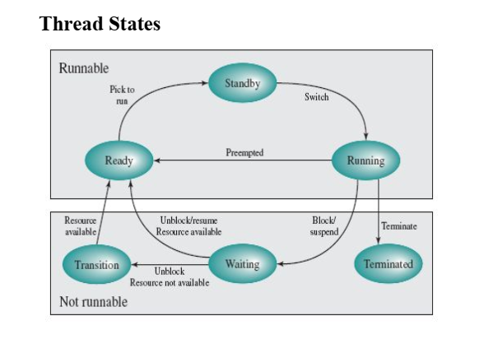

Slide 79
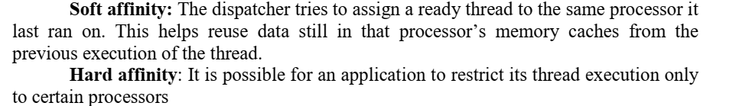

Slide 80
Thread Scheduling
Distinction between user-level and kernel-level threads
When threads supported, threads scheduled, not processes
Many-to-one and many-to-many models, thread library schedules user-level threads to run on LWP
  Known as process-contention scope (PCS) since scheduling competition is within the process
  Typically done via priority set by programmer
Kernel thread scheduled onto available CPU is system-contention scope (SCS) – competition among all threads in system

Slide 81
Multiple-Processor Scheduling – Load Balancing
If SMP, need to keep all CPUs loaded for efficiency
Load balancing attempts to keep workload evenly distributed
Push migration – periodic task checks load on each processor, and if found pushes task from overloaded CPU to other CPUs
Pull migration – idle processors pulls waiting task from busy processor

Slide 82


Multithreaded Multicore System

Slide 83
Process Synchronization
Background
The Critical-Section Problem
Mutex Locks
Semaphores
Classic Problems of Synchronization
Monitors

Slide 84
Background
Processes can execute concurrently
  May be interrupted at any time, partially completing execution
Concurrent access to shared data may result in data inconsistency
Maintaining data consistency requires mechanisms to ensure the orderly execution of cooperating processes
Illustration of the problem:
Suppose that we wanted to provide a solution to the consumer-producer problem that fills all the buffers. We can do so by having an integer counter that keeps track of the number of full buffers. Initially, counter is set to 0. It is incremented by the producer after it produces a new buffer and is decremented by the consumer after it consumes a buffer.

Slide 85
Interprocess Communication
Processes within a system may be independent or cooperating
Cooperating process can affect or be affected by other processes, including sharing data
Reasons for cooperating processes:
  Information sharing
  Computation speedup
  Modularity
  Convenience
Cooperating processes need interprocess communication (IPC)
Two models of IPC
  Shared memory
  Message passing

Slide 86

Communications Models
(a) Message passing. (b) shared memory.

Slide 87
Cooperating Processes
Independent process cannot affect or be affected by the execution of another process
Cooperating process can affect or be affected by the execution of another process
Advantages of process cooperation
  Information sharing
  Computation speed-up
  Modularity
  Convenience

Slide 88
Buffering
Queue of messages attached to the link.
implemented in one of three ways
  1. Zero capacity – no messages are queued on a link.
  Sender must wait for receiver (rendezvous)
  2. Bounded capacity – finite length of n messages
  Sender must wait if link full
  3. Unbounded capacity – infinite length
  Sender never waits

Slide 89
Interprocess Communication – Shared Memory
An area of memory shared among the processes that wish to communicate
The communication is under the control of the users processes not the operating system.
Major issues is to provide mechanism that will allow the user processes to synchronize their actions when they access shared memory.

Slide 90
Interprocess Communication – Message Passing
Mechanism for processes to communicate and to synchronize their actions
Message system – processes communicate with each other without resorting to shared variables
IPC facility provides two operations:
  send(message)
  receive(message)
The message size is either fixed or variable

Slide 91
Message Passing
Implementation of communication link
  Physical:
    Shared memory
    Hardware bus
    Network
  Logical:
    Direct or indirect
    Synchronous or asynchronous
    Automatic or explicit buffering

Slide 92
Direct Communication
Processes must name each other explicitly:
  send (P, message) – send a message to process P
  receive(Q, message) – receive a message from process Q
Properties of communication link
  Links are established automatically
  A link is associated with exactly one pair of communicating processes
  Between each pair there exists exactly one link
  The link may be unidirectional, but is usually bi-directional

Slide 93
Indirect Communication
Messages are directed and received from mailboxes (also referred to as ports)
  Each mailbox has a unique id
  Processes can communicate only if they share a mailbox
Properties of communication link
  Link established only if processes share a common mailbox
  A link may be associated with many processes
  Each pair of processes may share several communication links
  Link may be unidirectional or bi-directional

Slide 94
Synchronization
Message passing may be either blocking or non-blocking
Blocking is considered synchronous
  Blocking send -- the sender is blocked until the message is received
  Blocking receive -- the receiver is blocked until a message is available
Non-blocking is considered asynchronous
  Non-blocking send -- the sender sends the message and continue
  Non-blocking receive -- the receiver receives:
    A valid message, or
    Null message
Different combinations possible
  If both send and receive are blocking, we have a rendezvous

Slide 95
Producer-Consumer Problem
Paradigm for cooperating processes, producer process produces information that is consumed by a consumer process
  unbounded-buffer places no practical limit on the size of the buffer
  bounded-buffer assumes that there is a fixed buffer size

Slide 96
Bounded-Buffer – Shared-Memory Solution
Shared data
      #define BUFFER_SIZE 10
      typedef struct {
      . . .
      } item;
      item buffer[BUFFER_SIZE];
      int in = 0;
      int out = 0;
Solution is correct, but can only use BUFFER_SIZE-1 elements

Slide 97
Bounded-Buffer – Producer
item next_produced; (Buffer Size =5, in =0, out =0)
while (true)
{
/* produce an item in next produced */
while (((in + 1) % BUFFER_SIZE) == out); /* do nothing */
buffer[in] = next_produced;
in = (in + 1) % BUFFER_SIZE;
}

Slide 98
Bounded Buffer – Consumer
item next_consumed;
while (true)
{
while (in == out)
; /* do nothing */
next_consumed = buffer[out];
out = (out + 1) % BUFFER_SIZE;
/* consume the item in next consumed */
}

Slide 99
Producer
while (true) {
/* produce an item in next produced */
while(counter == BUFFER_SIZE)
/* do nothing */
buffer[in] = next_produced;
in = (in + 1) % BUFFER_SIZE;
counter++;
}

Slide 100
Consumer
while (true) {
while (counter == 0)
; /* do nothing */
next_consumed = buffer[out];
out = (out + 1) % BUFFER_SIZE;
counter--;
/* consume the item in next consumed */
}

Slide 101
Race Condition
counter++ could be implemented as
register1 = counter
register1 = register1 + 1
counter = register1
counter-- could be implemented as
register2 = counter
register2 = register2 - 1
counter = register2

Slide 102
Race Condition
Consider this execution interleaving with “count = 5” initially:
  S₀ : producer execute register1 = counter {register1 = 5}
  S₁: producer execute register1 = register1 + 1 {register1 = 6}
  S₂: consumer execute register2 = counter {register2 = 5}
  S₃: consumer execute register2 = register2 – 1 {register2 = 4}
  S₄: producer execute counter = register1 {counter = 6 }
  S₅: consumer execute counter = register2 {counter = 4}

Slide 103
Race Condition
P1()
{
C=B-1; // step 1
B=2*C; // step 2
}
P2()
{
D=2*B; // step 3
B=D-1; // step 4
} Find the various case studies and PT that the race condition exists or not?
1,2,3,4 : 3,4,1,2: 1,3,4,2: 3,1,2,4: 1,3,2,4: 3,1,4,2

Slide 104
Critical Section Problem
Consider system of n processes {p₀, p₁, … p_{n-1}}
Process has critical section segment of code :
  Process may be changing common variables, updating table, writing file, etc
  When one process in critical section, no other may be in its critical section
Critical section problem is to design protocol to solve this
Each process must ask permission to enter critical section in entry section, may follow critical section with exit section, then remainder section

Slide 105
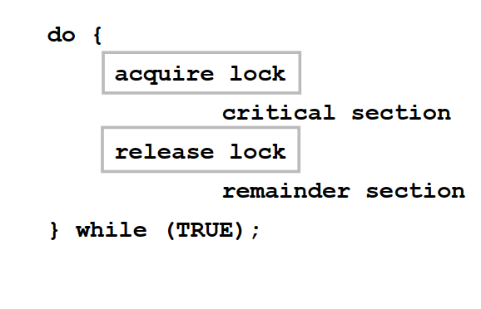
Critical Section
General structure of process P_{i}

Slide 106
Solution to Critical-Section Problem
1. Mutual Exclusion - If process P_{i} is executing in its critical section, then no other processes can be executing in their critical sections
2. Progress - If no process is executing in its critical section and there exist some processes that wish to enter their critical section, then the selection of the processes that will enter the critical section next cannot be postponed indefinitely
3. Bounded Waiting - A bound must exist on the number of times that other processes are allowed to enter their critical sections after a process has made a request to enter its critical section and before that request is granted
  Assume that each process executes at a nonzero speed
  No assumption concerning relative speed of the n processes

Slide 107
Critical-Section Handling in OS
Two approaches depending on if kernel is preemptive or non- preemptive
  Preemptive – allows preemption of process when running in kernel mode
  Non-preemptive – runs until exits kernel mode, blocks, or voluntarily yields CPU
    Essentially free of race conditions in kernel mode

Slide 108
Algorithm for Process P_{i}
do {
while (turn != i);
critical section
turn = j;
remainder section
} while (true);

Slide 109
Synchronization Hardware
Many systems provide hardware support for implementing the critical section code.
All solutions below based on idea of locking
  Protecting critical regions via locks
Uniprocessors – could disable interrupts
  Currently running code would execute without preemption
  Generally too inefficient on multiprocessor systems
    Operating systems using this not broadly scalable
Modern machines provide special atomic hardware instructions
    Atomic = non-interruptible
  Either test memory word and set value
  Or swap contents of two memory words

Slide 110
Solution to Critical-section Problem Using Locks
do {
acquire lock
critical section
release lock
remainder section
} while (TRUE);

Slide 111
test_and_set Instruction
Definition:
boolean test_and_set (boolean *target)
{
boolean rv = *target;
*target = TRUE;
return rv:
}
Executed atomically
Returns the original value of passed parameter
Set the new value of passed parameter to “TRUE”.

Slide 112
Solution using test_and_set()
Shared Boolean variable lock, initialized to FALSE
Solution:
do
{
while (test_and_set(&lock)) ; /* do nothing */
/* critical section */
lock = false;
/* remainder section */
} while (true);

Slide 113
compare_and_swap Instruction
Definition:
int compare _and_swap(int *value, int expected, int new_value)
{
int temp = *value;
if (*value == expected)
*value = new_value;
return temp;
}
Executed atomically
Returns the original value of passed parameter “value”
Set the variable “value” the value of the passed parameter “new_value” but only if “value” ==“expected”. That is, the swap takes place only under this condition.

Slide 114
Solution using compare_and_swap
Shared integer “lock” initialized to 0;
Solution:
do
{
while (compare_and_swap(&lock, 0, 1) != 0)
; /* do nothing */
/* critical section */
lock = 0;
/* remainder section */
} while (true);

Slide 115
Mutex Locks
Previous solutions are complicated and generally inaccessible to application programmers
OS designers build software tools to solve critical section problem
Simplest is mutex lock
Protect a critical section by first acquire() a lock then release() the lock
  Boolean variable indicating if lock is available or not
Calls to acquire() and release() must be atomic
  Usually implemented via hardware atomic instructions
But this solution requires busy waiting
  This lock therefore called a spinlock

Slide 116
acquire() and release()
acquire() {
while (!available)
; /* busy wait */
available = false;;
}
release() {
available = true;
}
do {
acquire lock
critical section
release lock
remainder section
} while (true);

Slide 117
Semaphore
Synchronization tool that provides more sophisticated ways (than Mutex locks) for process to synchronize their activities.
Semaphore S – integer variable
Can only be accessed via two indivisible (atomic) operations
  wait() and signal()
    Originally called P() and V()
Definition of the wait() operation
  wait(S) {
  while (S <= 0)
  ; // busy wait
  S--;
  }
Definition of the signal() operation
  signal(S) {
  S++;
  }

Slide 118
Semaphore Usage
Counting semaphore – integer value can range over an unrestricted domain
Binary semaphore – integer value can range only between 0 and 1
  Same as a mutex lock
Can solve various synchronization problems
Consider P₁ and P₂ that require S₁ to happen before S₂
Create a semaphore “synch” initialized to 0
  P1:
  S₁;
  signal(synch);
  P2:
  wait(synch);
  S₂;

Slide 119
Semaphore Implementation
Must guarantee that no two processes can execute the wait() and signal() on the same semaphore at the same time
Thus, the implementation becomes the critical section problem where the wait and signal code are placed in the critical section
  Could now have busy waiting in critical section implementation
    But implementation code is short
    Little busy waiting if critical section rarely occupied
Note that applications may spend lots of time in critical sections and therefore this is not a good solution

Slide 120
Semaphore Implementation with no Busy waiting
With each semaphore there is an associated waiting queue
Each entry in a waiting queue has two data items:
  value (of type integer)
  pointer to next record in the list
Two operations:
  block – place the process invoking the operation on the appropriate waiting queue
  wakeup – remove one of processes in the waiting queue and place it in the ready queue
typedef struct
{
int value;
struct process *list;
} semaphore;

Slide 121
Implementation with no Busy waiting
wait(semaphore *S)
{
S.value --;
if (S.value < 0) {
add this process to S.list;
block();
}}
signal(semaphore *S)
{
S.value++;
if (S.value <=0) {
remove a process P from S.list;
wakeup(P);
}
}

Slide 122
Classical Problems of Synchronization
Classical problems used to test newly-proposed synchronization schemes
  1. Bounded-Buffer Problem
  2. Readers and Writers Problem
  3. Dining-Philosophers Problem

Slide 123
Bounded-Buffer Problem
n buffers, each can hold one item
Semaphore mutex initialized to the value 1
Semaphore full initialized to the value 0
Semaphore empty initialized to the value n

Slide 124
Bounded Buffer Problem
The structure of the producer process
do {
...
/* produce an item in next_produced */
...
wait(empty);
wait(mutex);
...
/* add next produced to the buffer */
...
signal(mutex);
signal(full);
} while (true);

Slide 125
Bounded Buffer Problem
The structure of the consumer process
Do {
wait(full);
wait(mutex);
...
/* remove an item from buffer to next_consumed */
...
signal(mutex);
signal(empty);
...
/* consume the item in next consumed */
...
} while (true);

Slide 126
Readers-Writers Problem
A data set is shared among a number of concurrent processes
  Readers – only read the data set; they do not perform any updates
  Writers – can both read and write
Problem – allow multiple readers to read at the same time
  Only one single writer can access the shared data at the same time
Several variations of how readers and writers are considered – all involve some form of priorities
Shared Data
  Data set
  Semaphore rw_mutex initialized to 1
  Semaphore mutex initialized to 1
  Integer read_count initialized to 0

Slide 127
Readers-Writers Problem
The structure of a writer process
do {
wait(rw_mutex);
...
/* writing is performed */
...
signal(rw_mutex);
} while (true);

Slide 128
Readers-Writers Problem
The structure of a reader process
do {
wait(mutex);
read_count++;
if (read_count == 1)
wait(rw_mutex);
signal(mutex);
...
/* reading is performed */
...
wait(mutex);
read count--;
if (read_count == 0)
signal(rw_mutex);
signal(mutex);
} while (true);

Slide 129
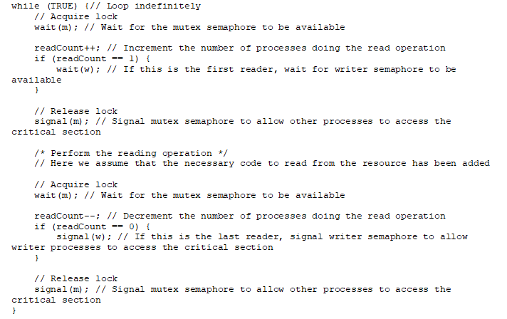

Slide 130
Readers-Writers Problem Variations
First variation – no reader kept waiting unless writer has permission to use shared object
Second variation – once writer is ready, it performs the write ASAP
Both may have starvation leading to even more variations
Problem is solved on some systems by kernel providing reader-writer locks

Slide 131

Dining-Philosophers Problem
Philosophers spend their lives alternating thinking and eating
Don’t interact with their neighbors, occasionally try to pick up 2 chopsticks (one at a time) to eat from bowl
  Need both to eat, then release both when done
In the case of 5 philosophers
  Shared data
    Bowl of rice (data set)
    Semaphore chopstick [5] initialized to 1

Slide 132
Dining-Philosophers Problem Algorithm
The structure of Philosopher i:
    do {
    wait (chopstick[i] );
    wait (chopStick[ (i + 1) % 5] );
    // eat
    signal (chopstick[i] );
    signal (chopstick[ (i + 1) % 5] );
    // think
    } while (TRUE);
What is the problem with this algorithm?

Slide 133
Problems with Semaphores
Incorrect use of semaphore operations:
  signal (mutex) …. wait (mutex)
  wait (mutex) … wait (mutex)
  Omitting of wait (mutex) or signal (mutex) (or both)
Deadlock and starvation are possible.

Slide 134
Monitors
A high-level abstraction that provides a convenient and effective mechanism for process synchronization
Abstract data type, internal variables only accessible by code within the procedure
Only one process may be active within the monitor at a time
But not powerful enough to model some synchronization schemes
    monitor monitor-name
    {
    // shared variable declarations
    procedure P1 (…) { …. }
    procedure Pn (…) {……}
    Initialization code (…) { … }
    }
    }

Slide 135

Schematic view of a Monitor

Slide 136
Condition Variables
condition x, y;
Two operations are allowed on a condition variable:
  x.wait() – a process that invokes the operation is suspended until x.signal()
  x.signal() – resumes one of processes (if any) that invoked x.wait()
    If no x.wait() on the variable, then it has no effect on the variable

Slide 137

Monitor with Condition Variables

Slide 138
Monitor Solution to Dining Philosophers
monitor DiningPhilosophers
{
enum { THINKING; HUNGRY, EATING) state [5] ;
condition self [5];
void pickup (int i) {
state[i] = HUNGRY;
test(i);
if (state[i] != EATING) self[i].wait;
}
void putdown (int i) {
state[i] = THINKING;
// test left and right neighbors
test((i + 4) % 5);
test((i + 1) % 5);
}

Slide 139
Solution to Dining Philosophers
void test (int i) {
if ((state[(i + 4) % 5] != EATING) &&
(state[i] == HUNGRY) &&
(state[(i + 1) % 5] != EATING) ) {
state[i] = EATING ;
self[i].signal () ;
}
}
initialization_code() {
for (int i = 0; i < 5; i++)
state[i] = THINKING;
}
}

Slide 140
Solution to Dining Philosophers
Each philosopher i invokes the operations pickup() and putdown() in the following sequence:
DiningPhilosophers.pickup(i);
EAT
DiningPhilosophers.putdown(i);
No deadlock, but starvation is possible

Slide 141
Monitor Implementation Using Semaphores
Variables
semaphore mutex; // (initially = 1)
semaphore next; // (initially = 0)
int next_count = 0;
Each procedure F will be replaced by
wait(mutex);
…
body of F;
…
if (next_count > 0)
signal(next)
else
signal(mutex);
Mutual exclusion within a monitor is ensured

Slide 142
Monitor Implementation – Condition Variables
For each condition variable x, we have:
semaphore x_sem; // (initially = 0)
int x_count = 0;
The operation x.wait can be implemented as:
x_count++;
if (next_count > 0)
signal(next);
else
signal(mutex);
wait(x_sem);
x_count--;

Slide 143
Monitor Implementation
The operation x.signal can be implemented as:
if (x_count > 0) {
next_count++;
signal(x_sem);
wait(next);
next_count--;
}

Slide 144
Resuming Processes within a Monitor
If several processes queued on condition x, and x.signal() executed, which should be resumed?
FCFS frequently not adequate
conditional-wait construct of the form x.wait(c)
  Where c is priority number
  Process with lowest number (highest priority) is scheduled next

Slide 145
Single Resource allocation
Allocate a single resource among competing processes using priority numbers that specify the maximum time a process plans to use the resource
R.acquire(t);
...
access the resource;
...
R.release;
Where R is an instance of type ResourceAllocator

Slide 146
A Monitor to Allocate Single Resource
monitor ResourceAllocator
{
boolean busy;
condition x;
void acquire(int time) {
if (busy)
x.wait(time);
busy = TRUE;
}
void release() {
busy = FALSE;
x.signal();
}
initialization code() {
busy = FALSE;
}
}

Slide 147
End of Unit II

Slide 148
Problems in CPU Scheduling

Slide 149

First- Come, First-Served (FCFS) Scheduling
Process Burst Time
P₁ 24
P₂ 3
P₃ 3
Suppose that the processes arrive in the order: P₁ , P₂ , P₃
The Gantt Chart for the schedule is:
Waiting time for P₁ = 0; P₂ = 24; P₃ = 27
Turnaround Time = Waiting Time + Burst Time
Turnaround Time for P₁ = (0+24)=24; P₂ = (24+3)=27; P₃ = (27+3)=30
Average waiting time: (0 + 24 + 27)/3 = 17

Slide 150

FCFS Scheduling
Suppose that the processes arrive in the order:
P₂ , P₃ , P₁
The Gantt chart for the schedule is:
Waiting time for P₁ = 6; P₂ = 0; P₃ = 3
Average waiting time: (6 + 0 + 3)/3 = 3
Much better than previous case
Convoy effect - short process behind long process
  Consider one CPU-bound and many I/O-bound processes

Slide 151
Shortest-Job-First (SJF) Scheduling
Associate with each process the length of its next CPU burst
  Use these lengths to schedule the process with the shortest time
SJF is optimal – gives minimum average waiting time for a given set of processes
  The difficulty is knowing the length of the next CPU request
  Could ask the user
  Preemptive version called shortest-remaining-time-first

Slide 152

Example of SJF
ProcessArriva l Time Burst Time
P₁ 0.0 6
P₂ 2.0 8
P₃ 4.0 7
P₄ 5.0 3
SJF scheduling chart
Waiting time for P₁ = 3; P₂ = 16; P₃ = 9; P₄ = 0
Average waiting time = (3 + 16 + 9 + 0) / 4 = 7

Slide 153

Example of Shortest-remaining-time-first
Now we add the concepts of varying arrival times and preemption to the analysis
ProcessA Arrival TimeT Burst Time
P₁ 0 8
P₂ 1 4
P₃ 2 9
P₄ 3 5
Preemptive SJF Gantt Chart
Average waiting time = [(10-1)+(1-1)+(17-2)+5-3)]/4 = 26/4 = 6.5 msec
Waiting Time = Finishing Time-(Arrival time + Burst Time)
WT of P₁ = 17-(0+8) = 9

Slide 154
Priority Scheduling
A priority number (integer) is associated with each process
The CPU is allocated to the process with the highest priority (smallest integer  highest priority)
  Preemptive
  Nonpreemptive
SJF is priority scheduling where priority is the inverse of predicted next CPU burst time
Problem Starvation – low priority processes may never execute
Solution Aging – as time progresses increase the priority of the process

Slide 155
Example of Priority Scheduling
ProcessA arri Burst TimeT Priority
P₁ 10 3
P₂ 1 1
P₃ 2 4
P₄ 1 5
P₅ 5 2
Priority scheduling Gantt Chart
0 1 6 16 18 19
Waiting Time for P₁ = 6; P₂ = 0; P₃ = 16; P₄ = 18; P₅ = 1
Average waiting time =(6+0+16+18+1)/5= 8.2 msec
P₂ | P₅ | P₁ | P₃ | P₄

Slide 156
Problem
Consider the following set of processes, with the length of the CPU burst given in milliseconds:
Process Burst Time Priority
--------- ------------- -----------
P1 2 2
P2 1 1
P3 8 4
P4 4 2
P5 5 3
The processes are assumed to have arrived in the order P1, P2, P3, P4, P5, all at time 0.
a. Draw four Gantt charts that illustrate the execution of these processes using the following scheduling algorithms: FCFS, SJF, priority, and RR (quantum = 2).
b. What is the turnaround time of each process for each of the scheduling algorithms in part a?
c. What is the waiting time of each process for each of these scheduling algorithms?

Slide 157
First Come First Serve (FCFS)
Process Burst Time Priority
--------- ------------- -----------
P1 2 2
P2 1 1
P3 8 4
P4 4 2
P5 5 3
0 2 3 11 15 20
Process WT TT
P1 0 2 p2 2 3 p3 3 11 p4 11 15 p5 15 20
Average Waiting Time = (0+2+3+11+15)/5=6.2ms
Average Turnaround Time=(2+3+11+15+20)/5=10.2ms
P1 | P2 | P3 | P4 | P5

Slide 158
Shortest Job First (SJF)
Process Burst Time Priority
--------- ------------- -----------
P1 2 2
P2 1 1
P3 8 4
P4 4 2
P5 5 3
0 1 3 7 12 20
Process WT TT
P1 1 3
p2 0 1
p3 12 20
p4 3 7
p5 7 12
Average Waiting Time = (1+0+12+3+7)/5=4.6ms
Average Turnaround Time=(3+1+20+7+12)/5=8.6ms
p2 | p1 | p4 | p5 | p3

Slide 159
Priority
Process Burst Time Priority
--------- ------------- -----------
P1 2 2
P2 1 1
P3 8 4
P4 4 2
P5 5 3
0 1 3 7 12 20
Process WT TT
P1 1 3
p2 0 1
p3 12 20
p4 3 7
p5 7 12
Average Waiting Time = (1+0+12+3+7)/5=4.6ms
Average Turnaround Time=(3+1+20+7+12)/5=8.6ms
p2 | p1 | p4 | p5 | p3

Slide 160
Round Robin (TQ=2)
Process Burst Time Priority
--------- ------------- -----------
P1 2 2
P2 1 1
P3 8 4
P4 4 2
P5 5 3
0 2 3 5 7 9 11 13 15 17 18 20
Process WT TT
P1 0 2
p2 2 3
p3 12 20
p4 9 13
p5 13 18
Average Waiting Time = (0+2+12+9+13)/5=7.2ms
Average Turnaround Time=(2+3+20+13+18)/5=11.2ms
p1 | p2 | p3 | p4 | p5 | p3 | p4 | p5 | p3 | p5 | p3

Slide 161
First Come First Serve (FCFS)
Problem
Process Burst Time Arrival Time Priority
--------- ------------- --------------- -----------
P0 8 0 1
P1 4 3 5
P2 5 4 2
P3 9 2 3
P4 2 5 4
0 8 17 21 26 28
Process WT TT
P0 0 8
p1 14 18 WT = WT-AT
p2 17 22
p3 6 15
p4 21 23
Average Waiting Time = (0+14+17+6+21)/5=11.6ms
Average Turnaround Time=(8+18+22+15+23)/5=17.2ms
P0 | p3 | p1 | p2 | p4

Slide 162
Non Preemptive SJF
Process Burst Time Arrival Time Priority
--------- ------------- --------------- -----------
P0 8 0 1
P1 4 3 5
P2 5 4 2
P3 9 2 3
P4 2 5 4
0 8 10 14 19 28
Process WT TT
P0 0 8
p1 7 11 WT = WT-AT
p2 10 15
p3 17 26
p4 3 5
Average Waiting Time = (0+7+10+17+3)/5=7.4 ms
Average Turnaround Time=(8+11+15+26+5)/5=13 ms
P0 | p4 | p1 | p2 | p3

Slide 163
Preemptive SJF
Process Burst Time Arrival Time Priority
--------- ------------- --------------- -----------
P0 8 0 1
P1 4 3 5
P2 5 4 2
P3 9 2 3
P4 2 5 4
0 3 7 9 14 19 28
Process WT TT
P0 6 14
p1 0 4 WT = WT-AT
p2 10 15
p3 17 26
p4 2 4
Average Waiting Time = (6+0+10+17+2)/5 = 7 ms
Average Turnaround Time=(14+4+15+26+4)/5=12.6 ms
P0 | p1 | P4 | P0 | P2 | p3

Slide 164
Non Preemptive Priority
Process Burst Time Arrival Time Priority
--------- ------------- --------------- -----------
P0 8 0 1
P1 4 3 5
P2 5 4 2
P3 9 2 3
P4 2 5 4
0 8 13 22 24 28
Process WT TT
P0 0 8
p1 21 25 WT = WT-AT
p2 4 9
p3 11 20
p4 17 19
Average Waiting Time = (0+21+4+11+17)/5=10.6 ms
Average Turnaround Time=(8+25+9+20+19)/5=16.2 ms
P0 | P2 | P3 | P4 | P1

Slide 165
Preemptive Priority
Process Burst Time Arrival Time Priority
--------- ------------- --------------- -----------
P0 8 0 1
P1 4 3 5
P2 5 4 2
P3 9 2 3
P4 2 5 4
0 8 13 22 24 28
Process WT TT
P0 0 8
p1 21 25 WT = WT-AT
p2 4 9
p3 11 20
p4 17 19
Average Waiting Time = (0+21+4+11+17)/5=10.6 ms
Average Turnaround Time=(8+25+9+20+19)/5=16.2 ms
P0 | P2 | P3 | P4 | P1

Slide 166
Round Robin(TQ=4)
Process Burst Time Arrival Time Priority
--------- ------------- --------------- -----------
P0 8 0 1
P1 4 3 5
P2 5 4 2
P3 9 2 3
P4 2 5 4
0 4 8 12 16 18 22 26 27 28
Process WT TT
P0 14 22
p1 5 9 WT = WT-AT
p2 18 23
p3 17 26
p4 11 13
Average Waiting Time = (14+5+18+17+11)/5=13 ms
Average Turnaround Time=(22+9+23+26+13)/5=18.6 ms
P0 | P3 | P1 | P2 | P4 | p0 | p3 | p2 | p3

Slide 167
Example of RR with Time Quantum = 4
Process Burst Time
P₁ 24
P₂ 3
P₃ 3
The Gantt chart is:
Waiting Time for P₁ = (10-4) = 6 (or) 30-(0+24) = 6; P₂ = 4; P₃ = 7
Average Waiting Time = (6+4+7)/3=5.6 ms
Typically, higher average turnaround than SJF, but better response
q should be large compared to context switch time
q usually 10ms to 100ms, context switch < 10 usec

Slide 168

Algorithm Evaluation
How to select CPU-scheduling algorithm for an OS?
Determine criteria, then evaluate algorithms
Deterministic modeling
  Type of analytic evaluation
  Takes a particular predetermined workload and defines the performance of each algorithm for that workload
Consider 5 processes arriving at time 0:

Slide 169



Deterministic Evaluation
For each algorithm, calculate minimum average waiting time
Simple and fast, but requires exact numbers for input, applies only to those inputs
  FCS is 28ms:
  Non-preemptive SFJ is 13ms:
  RR is 23ms:

